Slide 1
Human Computer Interaction
Evaluation Techniques
Chapter 9a
Imran Siddiqi
imran.siddiqi@mcs.edu.pk

Slide 2
Evaluation
Tests usability and functionality of system
Occurs in laboratory, field and/or in collaboration with users
Evaluates both design and implementation
Should be considered at all stages in the design life cycle
Evaluation Techniques

Slide 3
Evaluation
Should occur throughout the design life cycle
Evaluation results – Feedback for design changes
Evaluation by
  Designer/Usability Expert: early designs and prototypes
  Actual users: Working prototype or implementation
User may be involved in early designs as well
Evaluation Techniques

Slide 4
Goals of Evaluation
1. Assess extent/accessibility of system functionality
    Functionality must accord with user requirements
    Design – enable users perform the intended tasks more easily
    Functionality – Available and clearly reachable
2. Assess user’s experience of Interaction
    How easy the system is to learn
    Usability and user satisfaction
    Enjoyment
Evaluation Techniques

Slide 5
Goals of Evaluation
3. Identify any problems
    Unexpected results
    Confusion amongst users
    Related to both functionality and Usability
Evaluation Techniques

Slide 6

Evaluation Techniques
Evaluation through
  Expert Analysis
  User Participation
Evaluation Techniques

Slide 7
Evaluation through Expert Analysis
First evaluation – Before any implementation (Ideally)
The later an error is discovered – the more costly it is
Evaluation methods – Designers/experts
  Identify areas that are likely to cause difficulties
Evaluation Techniques

Slide 8
Evaluation through Expert Analysis
Cognitive Walkthroughs
Heuristic Evaluations
Model-based Evaluations
Using previous studies in evaluation
Evaluation Techniques

Slide 9

Cognitive Walkthroughs
Code walkthrough
  Source Code inspection by reviewers
  Following paths through the algorithms or code as determined by input conditions and choices made along the way
Cognitive Walkthrough
  Evaluator ‘steps through’ an action sequence to check an interface for potential usability problems
  Steps: Sequence of actions to be performed in order to perform some task
Evaluation Techniques

Slide 10
Cognitive Walkthroughs
Main focus – How easy the system is to learn
  Learning through exploration
Evaluation Techniques

Slide 11


Cognitive Walkthrough - Inputs
1. Interface
  What is to be evaluated?
  Implementation or Prototype
    May not be complete but should be fairly detailed (e.g. location & wording of a menu)
2. Task(s)
  Description of the task(s) to be analyzed
  Should be representative task(s)
Evaluation Techniques

Slide 12
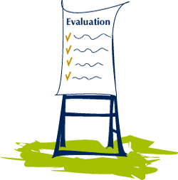
Cognitive Walkthrough - Inputs
3. Action Sequence
  What is the correct action sequence for each task?
  A complete list of actions needed to complete each task
  Example actions are: "press the RETURN key", "move cursor to 'File' menu"
  Could also be a sequence of several simple actions that a typical user could execute as a block, such as, "Select 'Save' from 'File' menu“
Evaluation Techniques

Slide 13


Cognitive Walkthrough - Inputs
4. Users
  Who will be the users of the System?
  Background experience or technical knowledge of intended users
  Example user: “Windows users who have worked with MS Word"
Evaluation Techniques

Slide 14
Cognitive Walkthrough - Procedure
Evaluator steps through the action sequence (‘3’)
For each step, the evaluator tries to answer the following four questions:
Evaluation Techniques

Slide 15
Cognitive Walkthrough - Procedure
1. Is the effect of the action the same as the user’s goal at that point?
  User performs some action – there is some effect
  Is it what the user was trying to do
  For example:
    Action: A Button Pressed
    Effect: Document Saved
    Is it ‘Saving the document’ that the user wanted?
Evaluation Techniques

Slide 16
Cognitive Walkthrough - Procedure
2. Will users see that the action is available?
  Will users see the button/icon/menu item that is used to produce the action
  Only visibility is concerned – Not Recognition
  For example, Remote control – Buttons hidden under a covered panel
Evaluation Techniques

Slide 17
Cognitive Walkthrough - Procedure
3. Once the users have found the correct action, will they know it is the one they need?
  Complements the previous question
  Will the user recognize the button/icon
Evaluation Techniques

Slide 18
Cognitive Walkthrough - Procedure
4. After the action is taken, will users understand the feedback they get?
  User performs a correct action – will he know he has done so?
  Confirmation of the action performed
  Similar to the execution – evaluation cycle
Evaluation Techniques

Slide 19
Cognitive Walkthrough - Documentation
Prepare standard evaluation forms
List the inputs (4 items in the first list), date & time of walkthrough, names of evaluators etc.
For each action (item 3 in the list) prepare a separate form
  Answers for the 4 questions in the second list
  Negative answers – document separately on the problem sheet
  Indicate the severity of the problem – how likely/serious it is
Evaluation Techniques

Slide 20
Cognitive Walkthrough – Example 1
Ticketing Machine
Evaluation Techniques

Slide 21
Cognitive Walkthrough - Example
Consider the following interface for a train ticket vending machine
1. Choose destination or enter fare
Newark
Rahway
Metropark
Metuchen
Edison
New Brunswick
2. Indicate journey type
One-way
Round-trip
3. Deposit money
coins
bills
LIFT for ticket and change
4. Press to receive ticket and change
Evaluation Techniques

Slide 22
Cognitive Walkthrough - Example
Scenario
  Nick is visiting a friend for a few days and wants to buy a one-way ticket to New Brunswick. Nick has a $5 bill in his pocket plus some loose change.
1. Choose destination or enter fare
Newark
Rahway
Metropark
Metuchen
Edison
New Brunswick
2. Indicate journey type
One-way
Round-trip
3. Deposit money
coins
bills
LIFT for ticket and change
4. Press to receive ticket and change
Evaluation Techniques

Slide 23
Cognitive Walkthrough - Example
Interface
  Standard size ticketing machine with push buttons, numeric keypad, LCD Display ….
Task
  Purchase a one-way ticket to New Brunswick
Action Sequence
  Press the button next to New Brunswick to chose the destination
  ….
Evaluation Techniques

Slide 24
Cognitive Walkthrough - Example
Users
  Ages 12+
  Normal vision
  Understanding of English
Evaluation Techniques

Slide 25
Cognitive Walkthrough - Example
Action: Press the button next to New Brunswick to chose the destination
Answer the four questions for this action
1. Is the effect of the action the same as the user’s goal at that point?
YES
1. Choose destination or enter fare
Newark
Rahway
Metropark
Metuchen
Edison
New Brunswick
2. Indicate journey type
One-way
Round-trip
3. Deposit money
coins
bills
LIFT for ticket and change
4. Press to receive ticket and change
Evaluation Techniques

Slide 26
Cognitive Walkthrough - Example
2. Will users see that the action is available?
1. Choose destination or enter fare
Newark
Rahway
Metropark
Metuchen
Edison
New Brunswick
2. Indicate journey type
One-way
Round-trip
Yes
3. Deposit money
coins
bills
LIFT for ticket and change
4. Press to receive ticket and change
Evaluation Techniques

Slide 27
Cognitive Walkthrough - Example
3. Will users recognize what they have located?
1. Choose destination or enter fare
Newark
Rahway
Metropark
Metuchen
Edison
New Brunswick
2. Indicate journey type
One-way
Round-trip
Yes
3. Deposit money
coins
bills
LIFT for ticket and change
4. Press to receive ticket and change
Evaluation Techniques

Slide 28

Cognitive Walkthrough - Example
4. Will users understand the feedback after the action?
1. Choose destination or enter fare
Newark
Rahway
Metropark
Metuchen
Edison
New Brunswick
2. Indicate journey type
One-way
Round-trip
3. Deposit money
coins
bills
LIFT for ticket and change
4. Press to receive ticket and change
Evaluation Techniques

Slide 29
Cognitive Walkthrough - Example
4. Will users understand the feedback after the action?
1. Choose destination or enter fare
Newark
Rahway
Metropark
Metuchen
Edison
New Brunswick
2. Indicate journey type
One-way
Round-trip
Yes (if button lights up…)
3. Deposit money
coins
bills
LIFT for ticket and change
4. Press to receive ticket and change
Evaluation Techniques

Slide 30
Cognitive Walkthrough - Example
Perform the same for each of the steps in the action sequence
1. Choose destination or enter fare
Newark
Rahway
Metropark
Metuchen
Edison
New Brunswick
2. Indicate journey type
One-way
Round-trip
3. Deposit money
coins
bills
LIFT for ticket and change
4. Press to receive ticket and change
Evaluation Techniques

Slide 31
Cognitive Walkthrough - Example
1. Choose destination or enter fare
Newark
Rahway
Metropark
Metuchen
Edison
New Brunswick
2. Indicate journey type
One-way
Round-trip
One-way
$6.35
3. Deposit money
coins
bills
LIFT for ticket and change
4. Press to receive ticket and change
Evaluation Techniques

Slide 32
Cognitive Walkthrough - Example
1. Choose destination or enter fare
Newark
Rahway
Metropark
Metuchen
Edison
New Brunswick
2. Indicate journey type
One-way
Round-trip
One-way
$6.35
3. Deposit money
coins
bills
$5
LIFT for ticket and change
4. Press to receive ticket and change
Evaluation Techniques

Slide 33
Cognitive Walkthrough - Example
1. Choose destination or enter fare
Newark
Rahway
Metropark
Metuchen
Edison
New Brunswick
2. Indicate journey type
One-way
Round-trip
One-way
$6.35
Recv’d: $5.00
3. Deposit money
coins
bills
LIFT for ticket and change
4. Press to receive ticket and change
Feedback! Amount Received
Evaluation Techniques

Slide 34
Cognitive Walkthrough - Example
Finish with a normal case first (e.g. completion of purchase)
Also be sure to handle common error cases
Examples:
  What if Nick realized he didn’t have enough money before putting it in?
  What if Nick realizes he doesn’t have enough only after putting in money?
Evaluation Techniques

Slide 35
Cognitive Walkthrough - Example
Cancel and get money back
Not enough $…
What does the user want to achieve?
1. Choose destination or enter fare
Newark
Rahway
Metropark
Metuchen
Edison
New Brunswick
2. Indicate journey type
One-way
Round-trip
One-way
$6.35
Recv’d: $5.00
3. Deposit money
coins
bills
LIFT for ticket and change
4. Press to receive ticket and change
Evaluation Techniques

Slide 36
Cognitive Walkthrough - Example
Not enough $…
Cancel and get back money
Will users see that the action is available?
Probably not!
1. Choose destination or enter fare
Newark
Rahway
Metropark
Metuchen
Edison
New Brunswick
2. Indicate journey type
One-way
Round-trip
One-way
$6.35
Recv’d: $5.00
3. Deposit money
coins
bills
?
?
?
LIFT for ticket and change
4. Press to receive ticket and change
Evaluation Techniques

Slide 37
Cognitive Walkthrough - Example
Will users see that the action is available?
Add a new UI element to make it clear!
1. Choose destination or enter fare
Newark
Rahway
Metropark
Metuchen
Edison
New Brunswick
2. Indicate journey type
One-way
Round-trip
One-way
$6.35
Recv’d: $5.00
3. Deposit money
coins
bills
Cancel & return money
LIFT for ticket and change
4. Press to receive ticket and change
Evaluation Techniques

Slide 38
Cognitive Walkthrough – Example 2
Call Forwarding
Forwarding calls on a campus telephone system, from the perspective of a first time user [Wharton et al., 1994]
Evaluation Techniques

Slide 39
Cognitive Walkthrough - Example
Interface
  Standard-size, touch-tone phone on desk. Overlay template includes the following information:
      FWD *2
      CNCL #2
      SEND ALL *3
Task
  Cancel current forwarding and forward calls instead to a colleague with the extension 1234.
Evaluation Techniques

Slide 40
Cognitive Walkthrough - Example
Action Sequence
1. Pick up the receiver.
Phone: dial tone
2. Press #2. Command to cancel forwarding
Phone: bip bip bip
3. Hang up the receiver
4. Pick up the receiver
Phone: dial tone
5. Press *2. Command to forward calls
Phone: dial tone
6. Press 1234.
Phone: bip bip bip
7. Hang up the receiver.
Evaluation Techniques

Slide 41
Cognitive Walkthrough - Example
Users
  Old/New faculty, staff, guests, and visitors
  For this evaluation assume that the user is a new university professor
Evaluation Techniques

Slide 42
Cognitive Walkthrough - Example
Pick up the receiver
Phone: dial tone
Answer the four questions for this action
Seems OK based on prior experience with phones.
Evaluation Techniques

Slide 43
Cognitive Walkthrough - Example
Press #2.
Phone: bip bip bip
Answer the four questions for this action
1. Is the effect of the action the same as the user’s goal at that point?
… But how does the user even know that forwarding is in effect?
2. Will users see that the action is available?
Yes, CNCL is visible on the template.
Evaluation Techniques

Slide 44
Cognitive Walkthrough - Example
Press #2.
Phone: bip bip bip
3. Will users recognize what they have located?
Might not recognize CNCL as the control to cancel forwarding
Might think that just pressing ’2’ is sufficient, instead of ’#2’
Might try to press the buttons simultaneously, rather than sequentially
4. Will users understand the feedback after the action?
How do first-time users know they have succeeded? After some experience, they will recognize the bips as confirmation, but will they at first?
Evaluation Techniques

Slide 45

Heuristic Evaluation
Evaluation Techniques

Slide 46
Heuristic Evaluation
Heuristics
  Guidelines, General Principle, Rule of thumbs
Heuristic Evaluation
  Critique of a system using a set of simple and general heuristics
  Developed by Neilsen and Molich
Evaluation Techniques

Slide 47
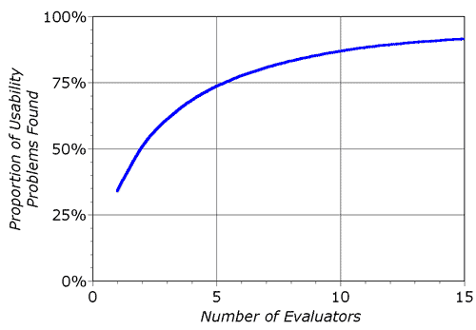
Heuristic Evaluation
Several evaluators independently critique a system for potential problems
Neilsen’s Experience: 3-5 evaluators
Evaluation Techniques

Slide 48
Heuristic Evaluation
Neilson’s 10 heuristics
Can be supplemented by domain specific heuristics if required
Evaluators
  Asses the system and note the violations of these heuristics
  Also asses the severity of the problem
Evaluation Techniques

Slide 49
Heuristic Evaluation
Problem Severity - Rating on a scale 0-4
  0 = I do not agree that this is a usability problem
  1 = Cosmetic Problem only, need not to be fixed unless extra time is available
  2 = Minor Usability Problem, Low priority fixation
  3 = Major Usability Problem, High priority fixation
  4 = Usability Catastrophe, Imperative to fix
Evaluation Techniques

Slide 50
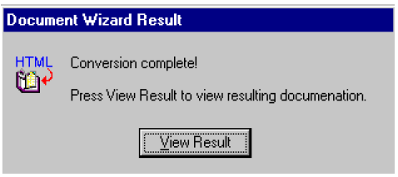
Nielsen’s 10 Heuristics
1. Visibility of System Status
  Always keep user informed about what is going on?
  Appropriate feedback – How long/ how much completed
  Cursor Change, Progress Bar
  Do not OVERDO it!
Evaluation Techniques

Slide 51
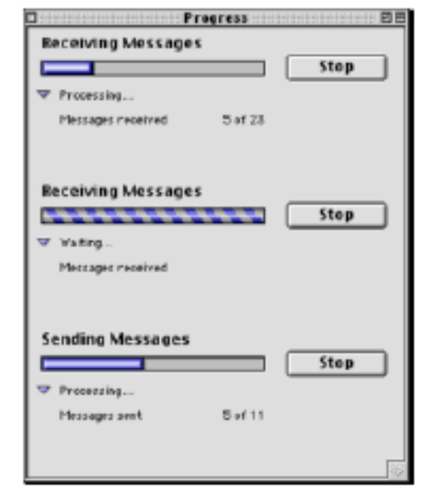
Nielsen’s 10 Heuristics
1. Visibility of System Status (Contd…)
  Response Time
    < 0.1 secs – Instantaneous
    0.1 – 1 secs – User notices, but no feedback needed
    1 – 5 secs – Display busy cursor
    > 5 secs – Display progress bar
Evaluation Techniques

Slide 52
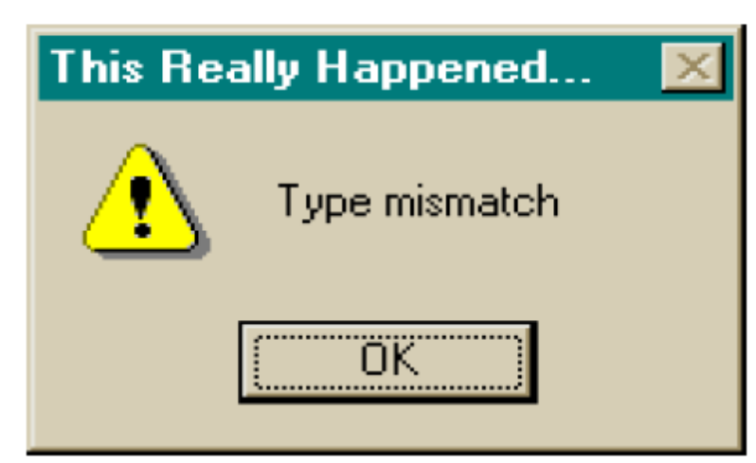
Nielsen’s 10 Heuristics
2. Match between system and the real world
  System should speak user’s language not system oriented terms
  Words, phrases and concepts – familiar to the user
Evaluation Techniques

Slide 53
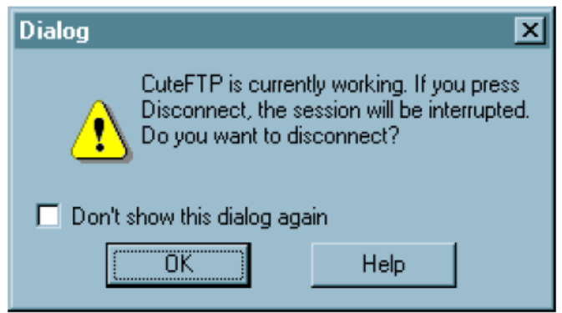
Nielsen’s 10 Heuristics
3. User control and freedom
  Users often make mistake and will need a clearly marked "emergency exit" to leave the unwanted state
  Support undo and redo
  Long operations should be cancelable
  All dialogs should have a cancel button
Evaluation Techniques

Slide 54
Nielsen’s 10 Heuristics
4. Consistency and Standards
  Principle of least surprise
  Similar things should look and act similar
  Different things should look different
  Properties
    Terminologies, Size, Location, Color, …
  Follow standards
Evaluation Techniques

Slide 55
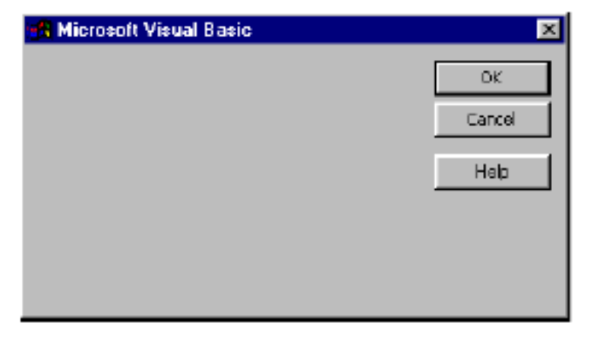
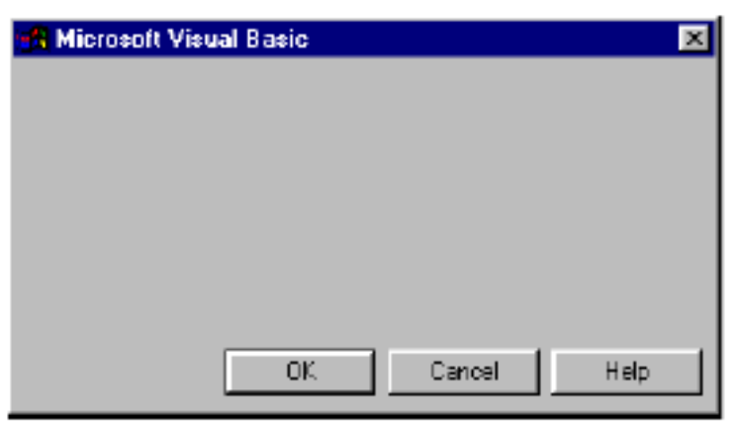
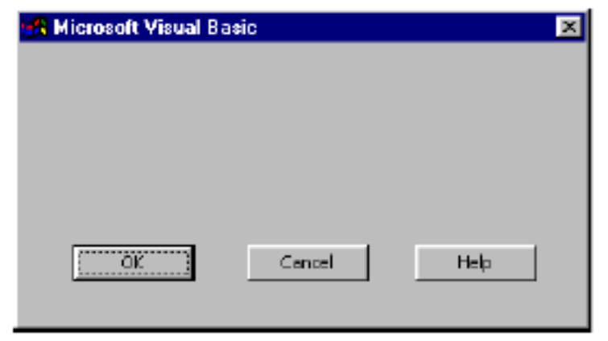
Nielsen’s 10 Heuristics
4. Consistency and Standards
Evaluation Techniques

Slide 56
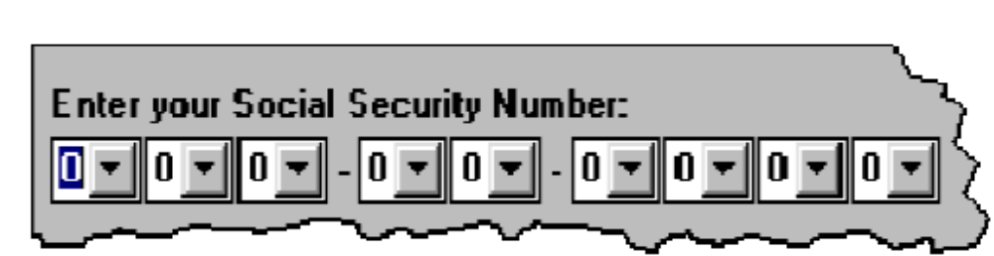
Nielsen’s 10 Heuristics
5. Error Prevention
  Make it difficult to make errors
  Better than good error messages is careful design which prevents a problem from occurring in the first place
  Selection is less error-prone than typing
    Don’t overdo it
Evaluation Techniques

Slide 57
Nielsen’s 10 Heuristics
5. Error Prevention (Contd…)
  Disable illegal commands
    Copy is impossible if nothing is selected – then the command should be disabled (“grayed out”) so that it simply can’t be selected in the first place.
  Avoid Modes
    If cant avoid – make it visible
Evaluation Techniques

Slide 58
Nielsen’s 10 Heuristics
6. Recognition rather than recall
  Minimize the user's memory load by making objects, actions, and options visible
  Instructions for use of the system should be visible or easily retrievable whenever appropriate
  Use menus not command language
  Use combo boxes not text boxes
Evaluation Techniques

Slide 59
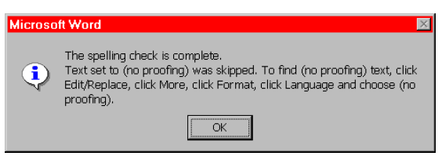
Nielsen’s 10 Heuristics
6. Recognition rather than recall
  Over reliance on user’s memory
  Modal dialog box, so the user can’t start following its instructions until after clicking OK
  Clicking OK the instructions vanish from the screen, and the user is left to struggle to remember them
Evaluation Techniques

Slide 60
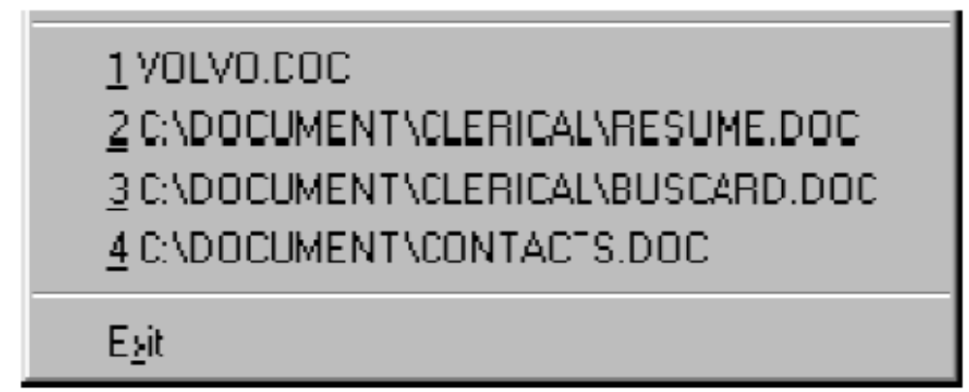
Nielsen’s 10 Heuristics
7. Flexibility and Efficiency
  Accelerators to speed up the interaction for expert user
  Can cater to both inexperienced and experienced users
    Keyboard accelerators, Command abbreviations, Bookmark, History
Evaluation Techniques

Slide 61
Nielsen’s 10 Heuristics
8. Aesthetic and minimalist design
  Less is More
  Do not use information which is irrelevant or rarely needed
  Every extra unit of info competes with the relevant units of info – diminishes their relative visibility
  Omit extraneous info, graphics, features
Evaluation Techniques

Slide 62
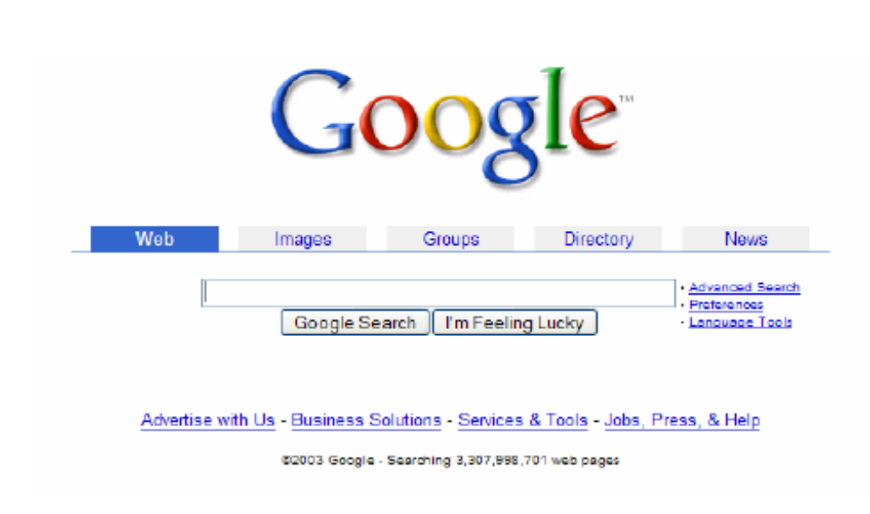
Nielsen’s 10 Heuristics
8. Aesthetic and minimalist design
Evaluation Techniques

Slide 63
Nielsen’s 10 Heuristics
9. Help users recognize, diagnose, and recover from errors
  If you cant prevent errors – give a good error message
  Should be in plain language (No codes)
  Be precise – Restate user’s input
    Not “Cannot open file”, but “Cannot open file named paper.doc”
  Give constructive help
    Why error occurred and how to fix it
  Be polite and non-blaming
    Not “fatal error”, not “illegal”
Evaluation Techniques

Slide 64
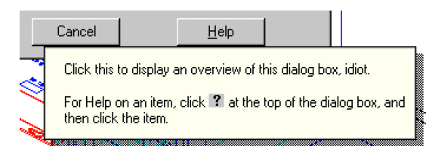
Nielsen’s 10 Heuristics
9. Help users recognize, diagnose, and recover from errors (Contd …)
  The tooltip shown comes from a production version of AutoCad!
  Inserted by a programmer as a joke, but somehow never removed before release.
Evaluation Techniques

Slide 65

Nielsen’s 10 Heuristics
10. Help and Documentation
  Users don’t read manuals
    Prefer to spend time working toward their task goals, not learning about your system
  But manuals and online help are vital
    Usually when user is frustrated or in crisis
  Help should be:
    Searchable, Concrete and Short
Evaluation Techniques

Slide 66

References
Chapter 9 - Human Computer Interaction by Dix et al.
Usability Engineering – Rob Miller, MIT
HCI & Interface Design – Jacek Gwidza
Interactive Design

